Slide 1
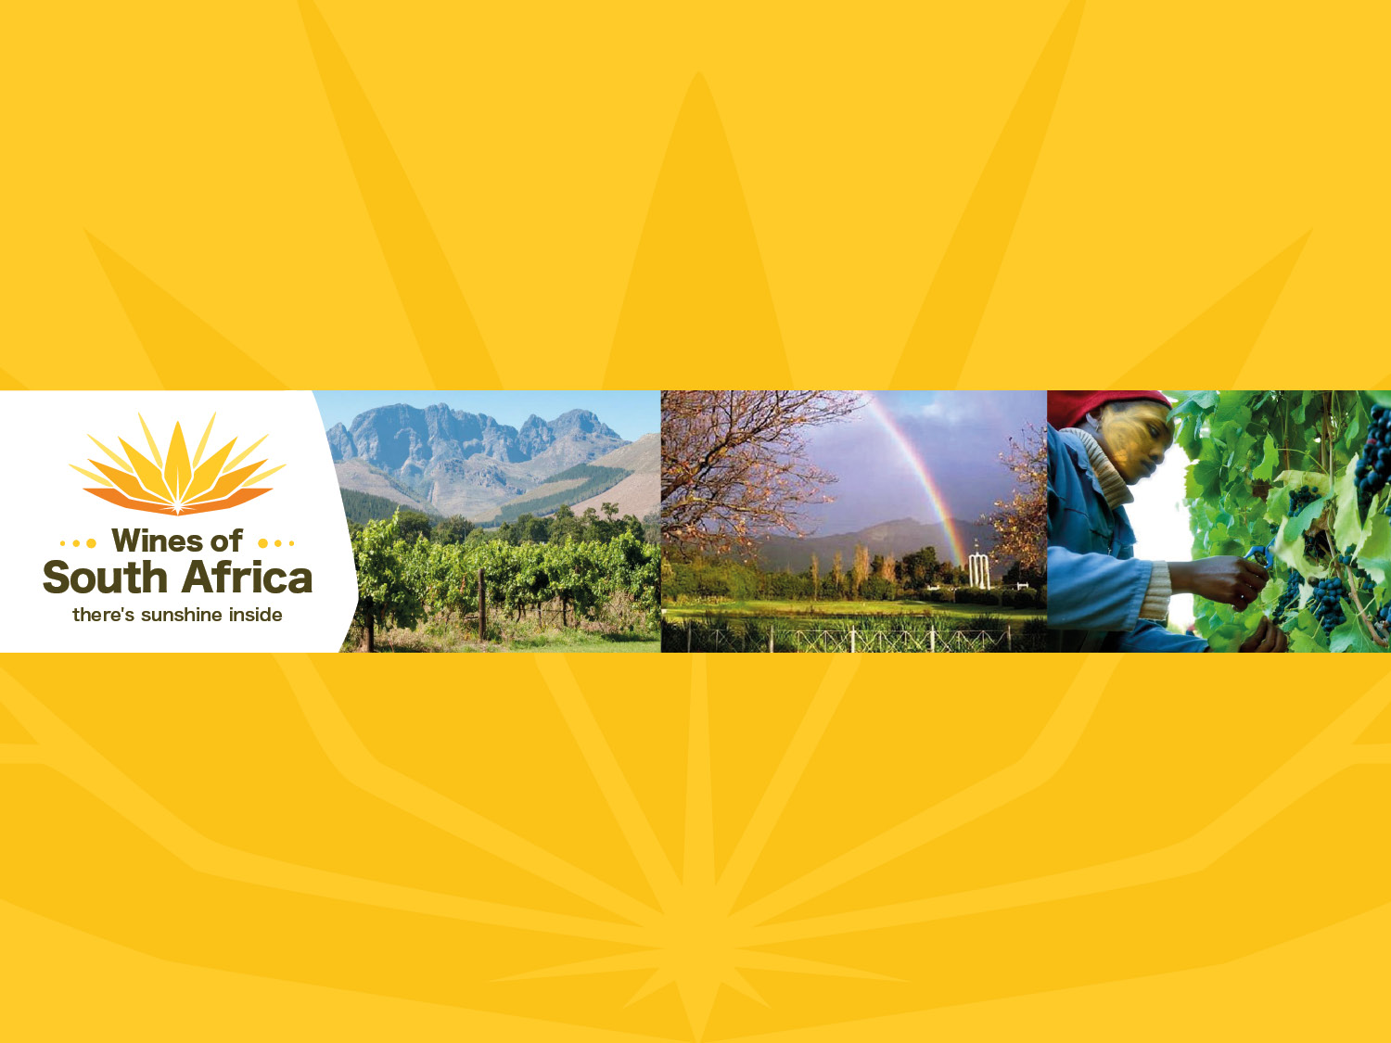
CAPE WINELANDS
FRANSCHHOEK VALLEY
Notes:
Wines of South Africa

Slide 2

Where is South Africa?

Slide 3

South Africa is the southernmost
country in Africa.

Slide 4

Our winelands are located at the
very tip of South Africa.

Slide 5

PRODUCTION AREAS: Districts of South Africa.

Slide 6

Wards of South Africa.

Slide 7

Coastal
Region: Coastal
District: Franschhoek Valley

Slide 8
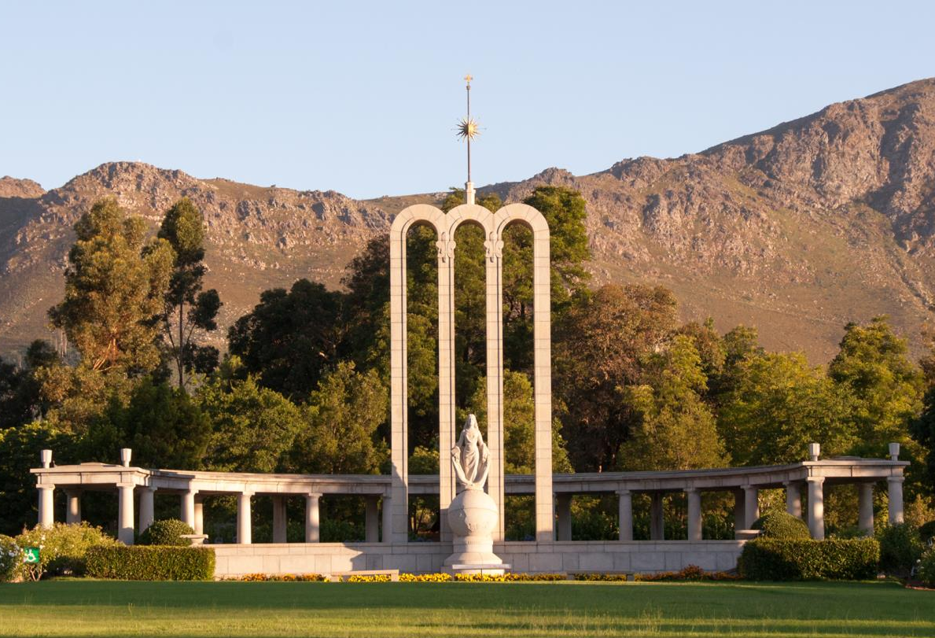
The district of Franschhoek has retained its
French Huguenot character.

Slide 9
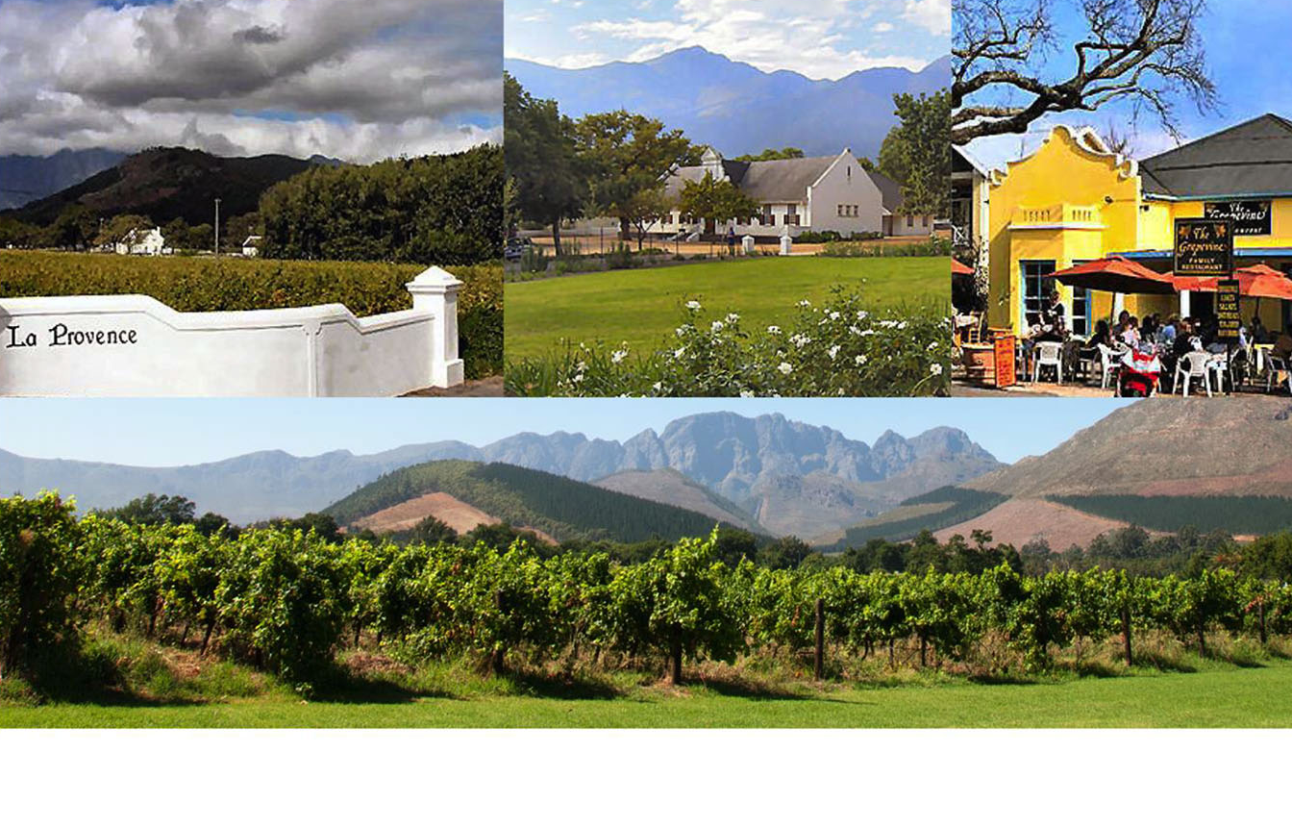
This French heritage is reflected in the names of many of the wine farms, guesthouses and restaurants.

Slide 10
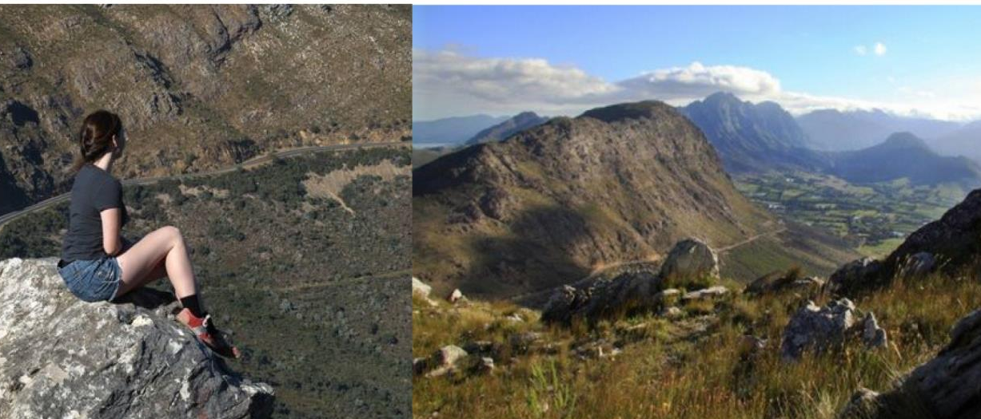
Franschhoek offers visitors numerous walks and biking trails in the surrounding mountains and many farms in the valley offer trout fishing in streams and dams, as well as horse riding.

Slide 11
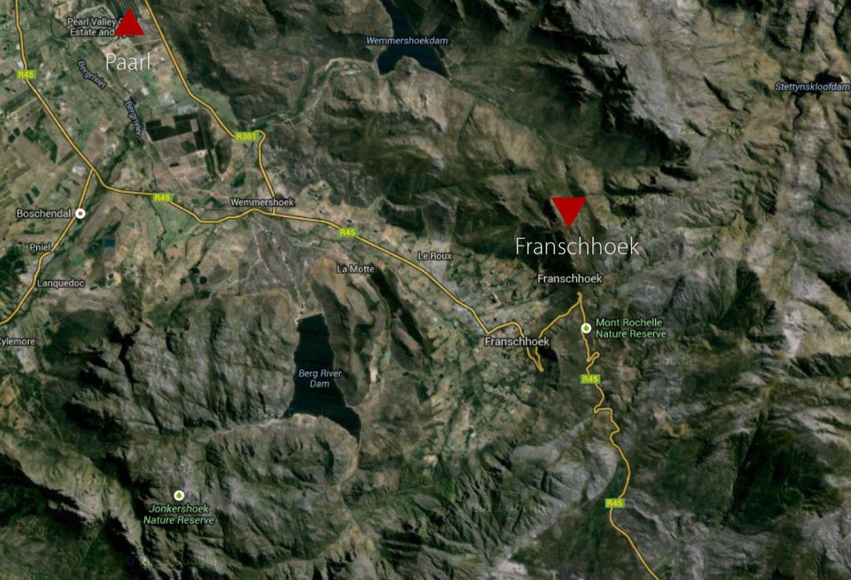
The Franschhoek valley lies to the south-east
of Paarl and is enclosed on three sides by towering mountains.

Slide 12
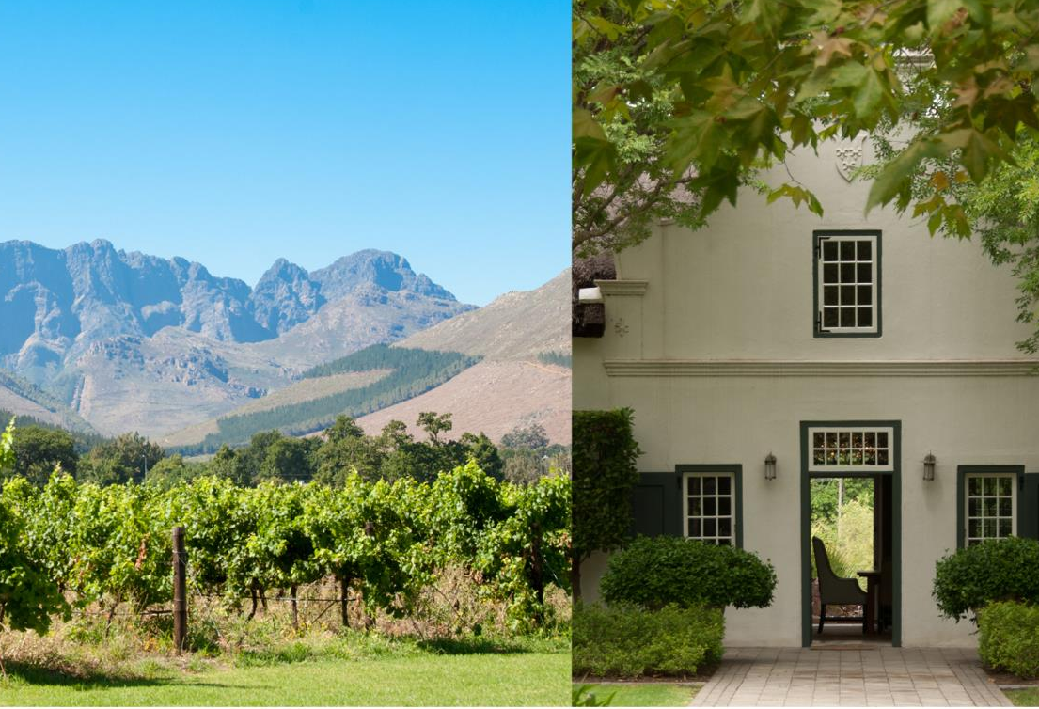
The Groot Drakenstein and Franschhoek mountains meet at the top of the valley.

Slide 13
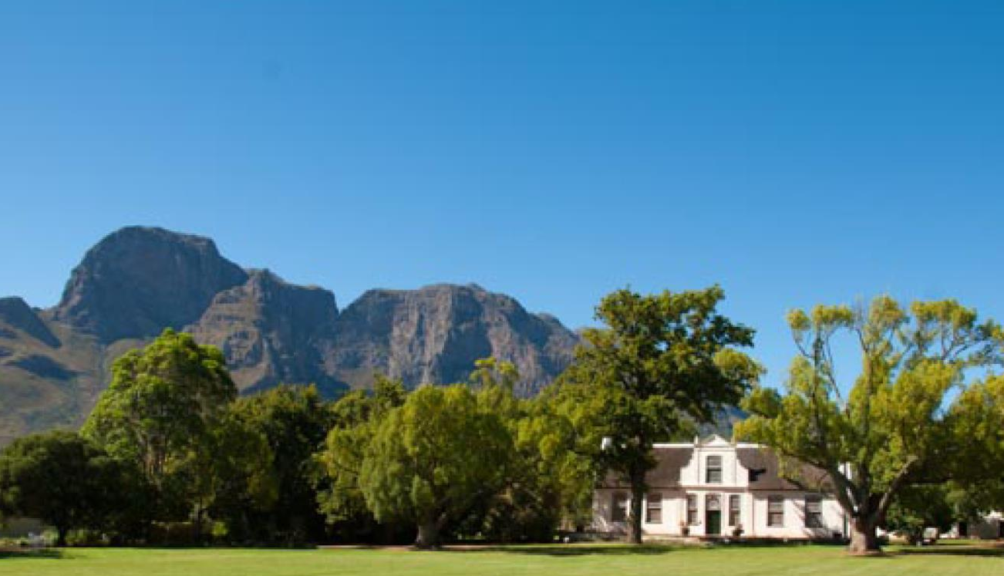
The Klein Drakenstein and Simonsberg mountains are found further down towards Paarl.

Slide 14
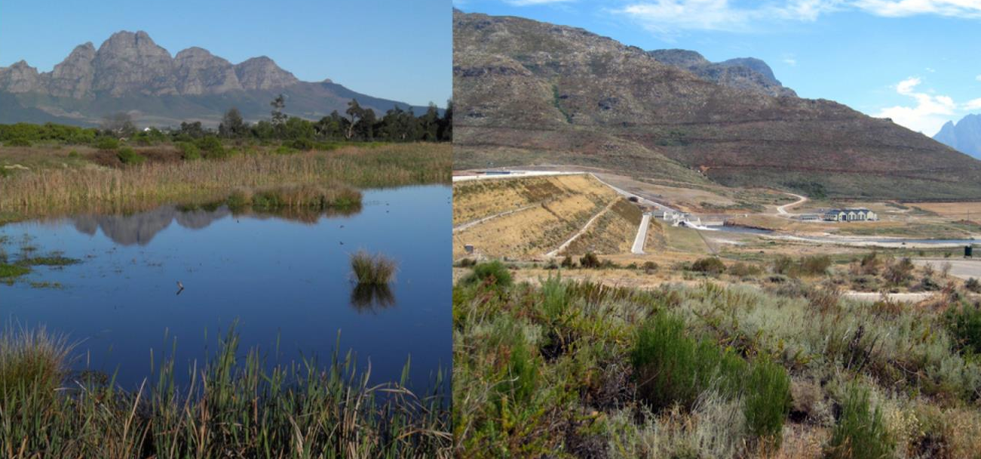
Streams from the higher peaks flow down to the valley floor where they converge to form the Berg River.

Slide 15
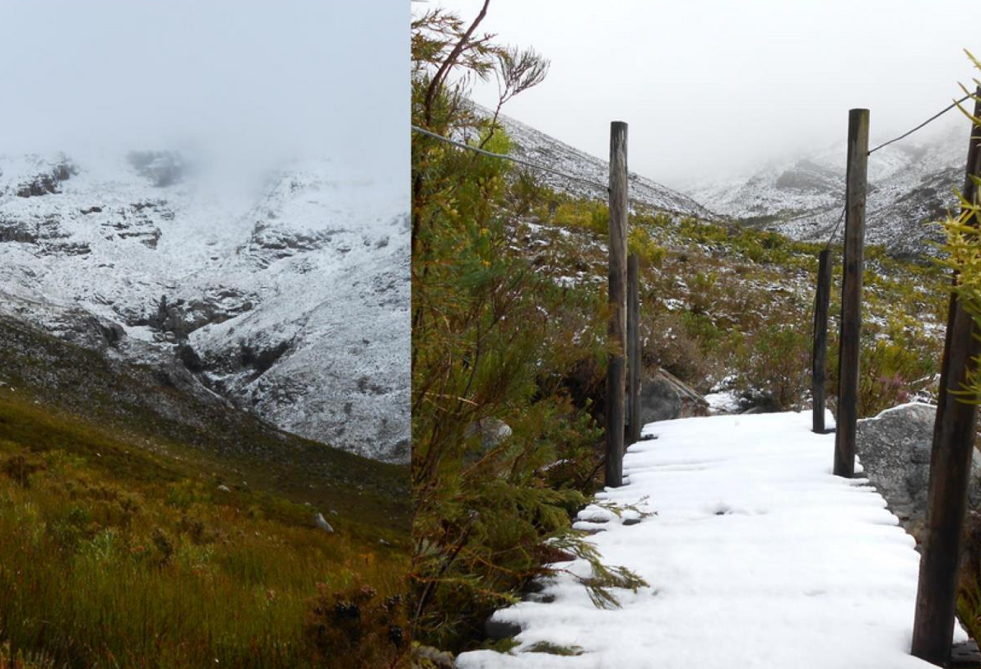
The river is fast-flowing in winter when snow caps the peaks.

Slide 16
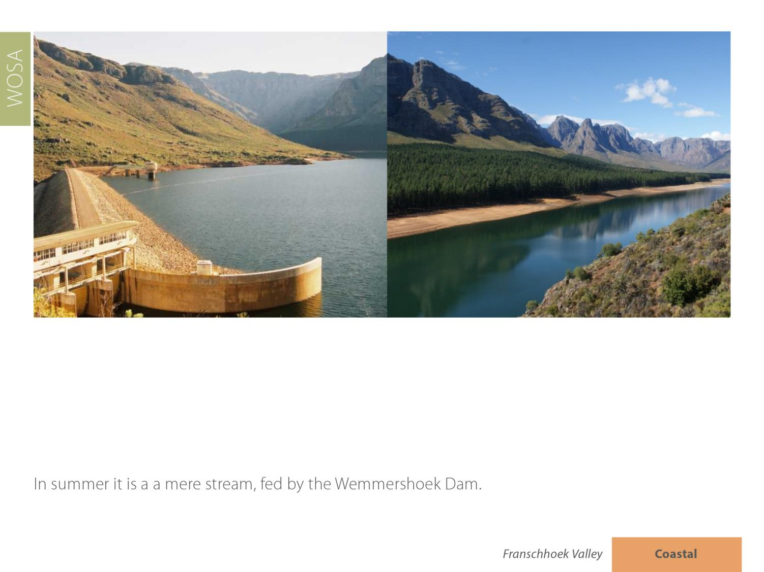
The entire picturesque village of Elim, which is a Moravian mission settlement that was founded in 1824, is a national monument.

Slide 17
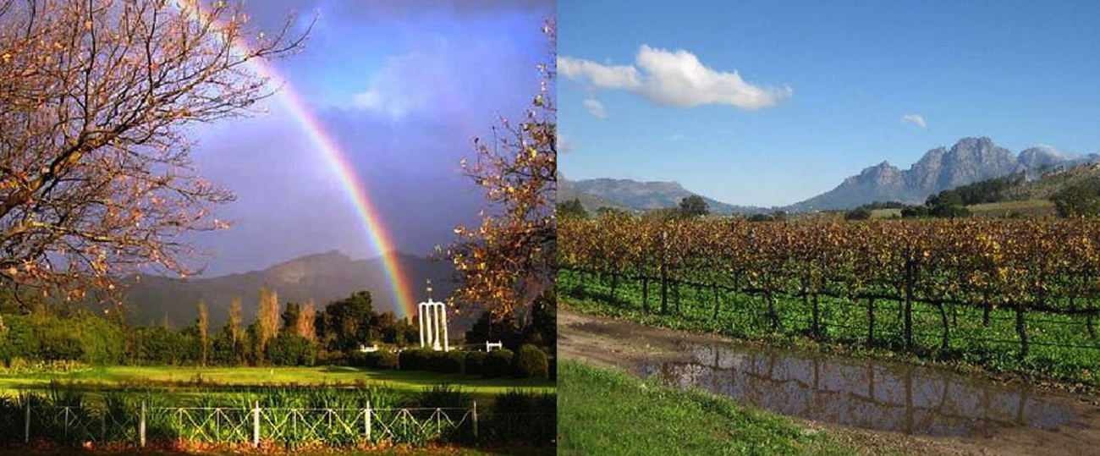
The average rainfall is between 900–1 050 mm and the mean February temperature is 23⁰C.

Slide 18
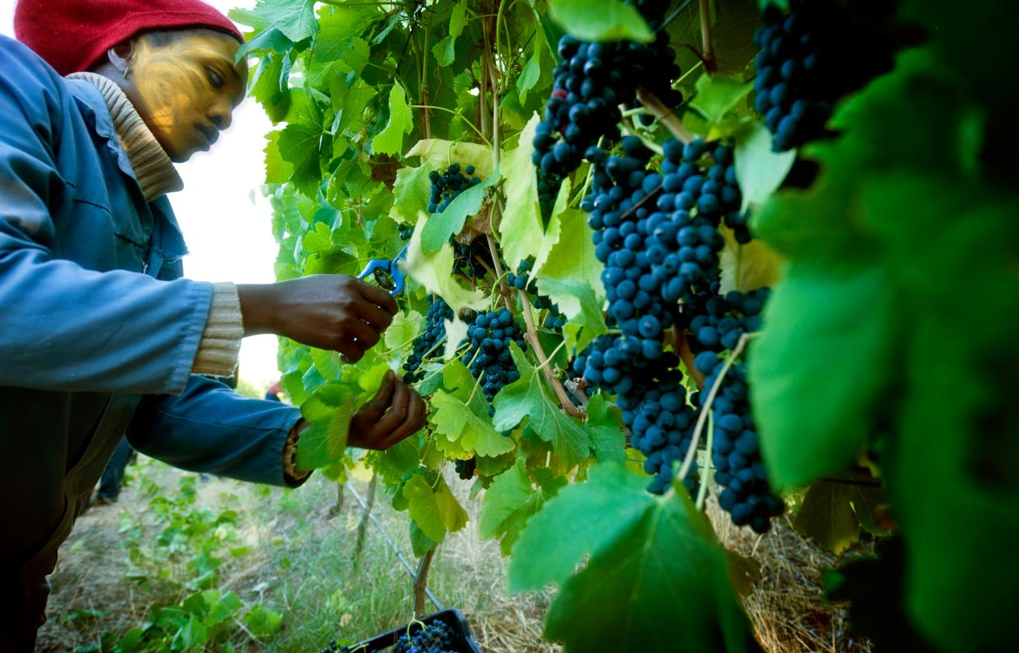
The climate and soil conditions vary considerably. Vines are planted on the banks of rivers and up mountain slopes, resulting in a wide range of wines.

Slide 19
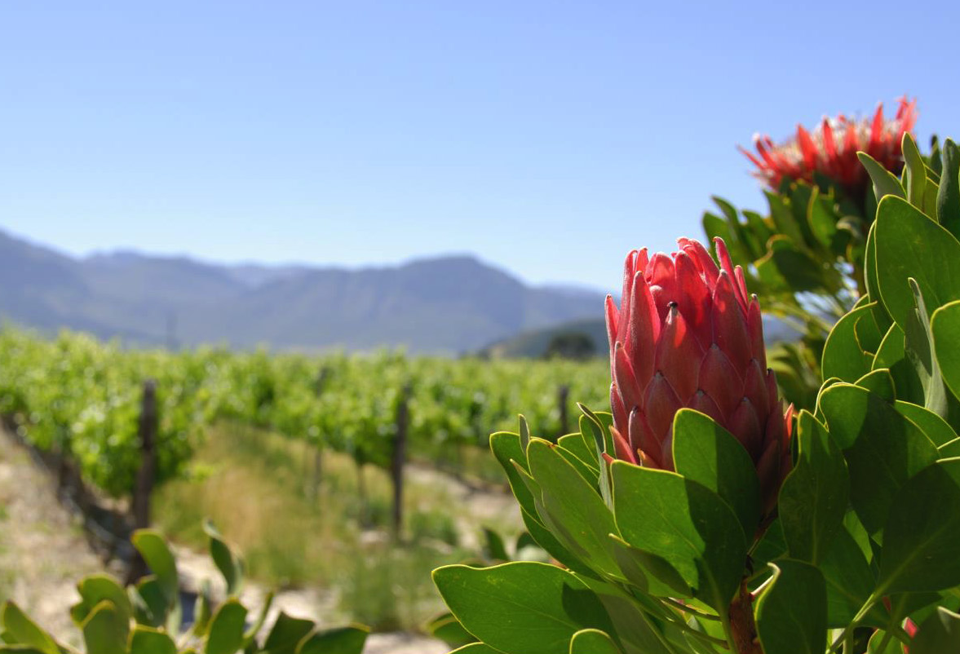
The most widely planted white-wine varieties are Chardonnay, Sauvignon Blanc and Semillon.

Slide 20
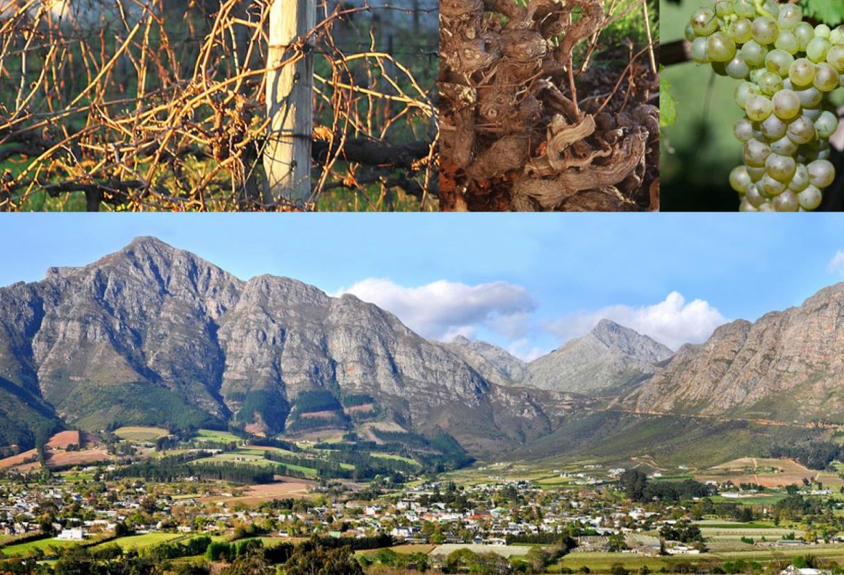
There are Semillon vines in the valley that are over 100 years old.

Slide 21
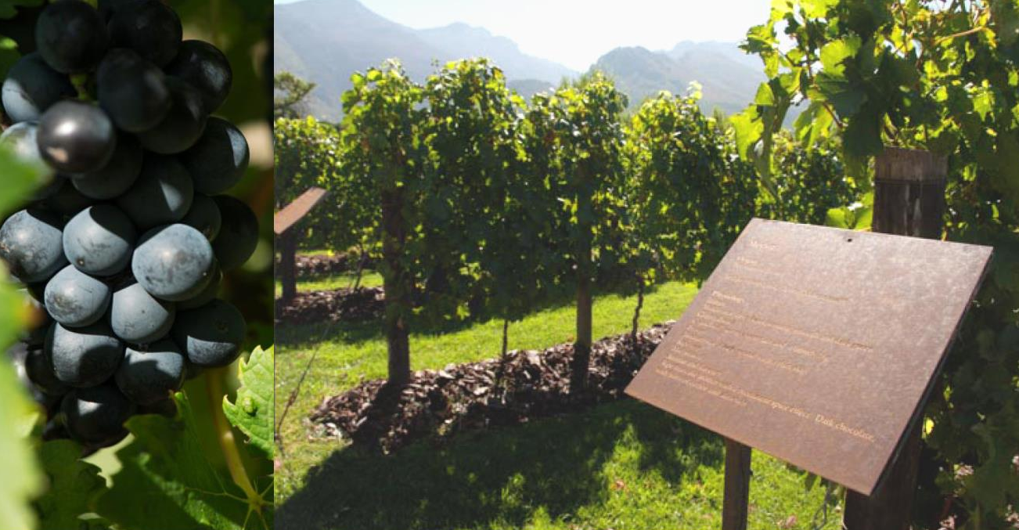
Cabernet Sauvignon, Shiraz and Merlot are the most widely planted red-wine varieties.

Slide 22
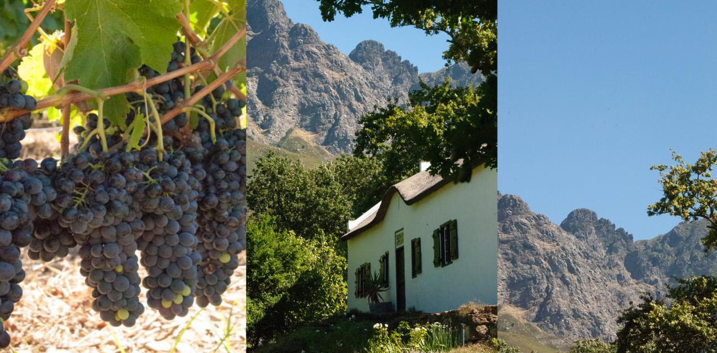
The valley is recognised for the quality of its Cabernet Sauvignon and Semillon.

Slide 23
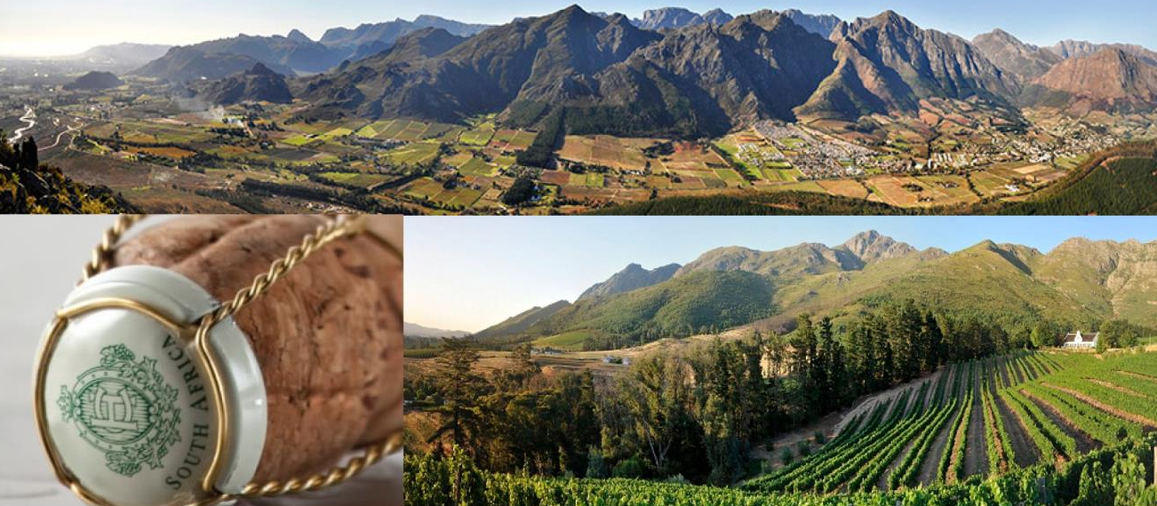
Franschhoek is also regarded as one of South Africa’s leading Cap Classique producing areas and has its own Cap Classique route.

Slide 24
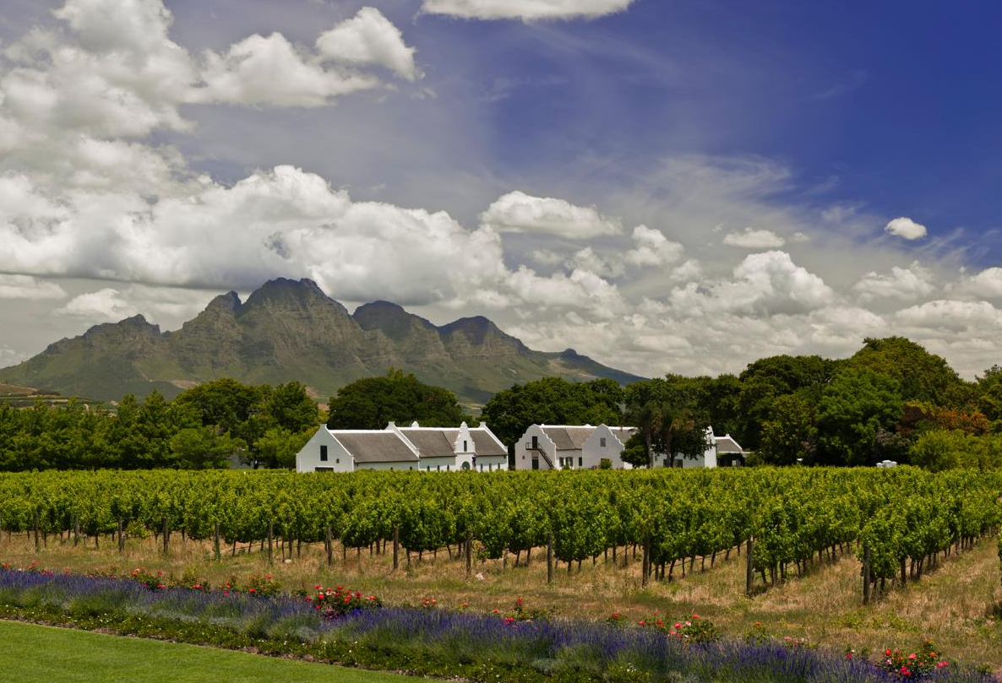
The images used in these presentations have been sourced from various producers, as well as industry and tourism bodies. These presentations are strictly for non-commercial, non-profit, educational purposes only and cannot be reproduced or transmitted in any form or by any means without written permission from Wines of South Africa (WoSA).

Slide 25
The Cape winelands, considered by many to be the most
beautiful in the world, have a network of diverse
and well-run wine routes, affording visitors a varied
and unforgettable experience.
The end
Notes:
The end

